Slide 1
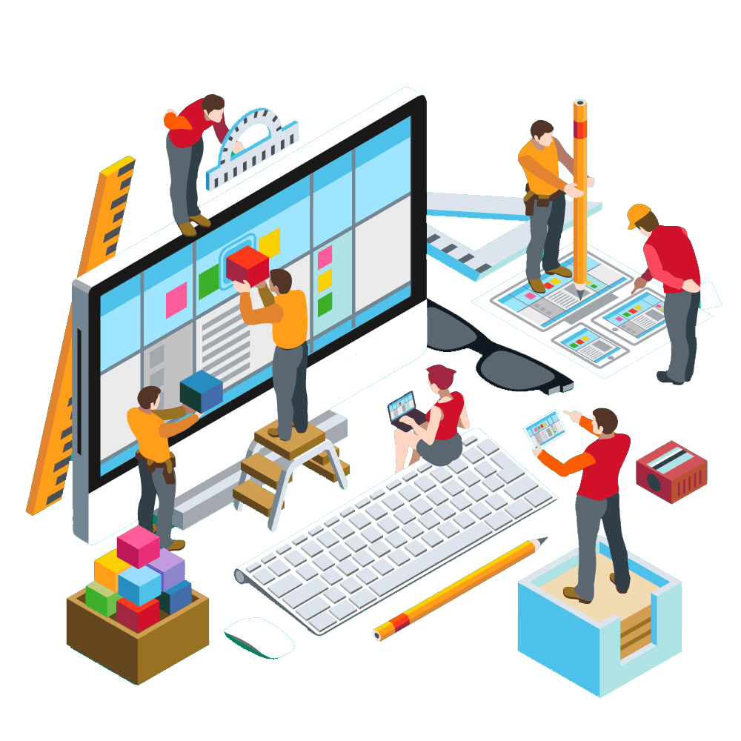
Professional Ethics and Human Values
Privacy

Slide 2
WhatsApp, an instant messaging app for smartphones, allows users to send text messages, documents, images, videos, user location data, and other data over the Internet to other WhatsApp users, using standard cellular mobile numbers.
In the past, WhatsApp has been a strong defender of its users’ privacy, employing end-to-end encryption for all messages sent through its service and regularly resisting requests from authorities for data access.
As a result, WhatsApp has been the instant messaging app of choice for users who wish to keep their conversations private, including individuals working to expose corruption within organizations and those reporting on the activities of totalitarian governments.

Slide 3
PRIVACY PROTECTION AND THE LAW
The use of information technology in both government and business requires balancing the needs of those who use the information that is collected against the rights and desires of the people whose information is being used.
Information about people is gathered, stored, analyzed, and reported because organizations can use it to make better decisions.
Some of these decisions, including whether or not to hire a job candidate, approve a loan, or offer a scholarship, can profoundly affect people’s lives.
In addition, the global marketplace and intensified competition have increased the importance of knowing consumers’ purchasing habits and financial condition.
Companies use this information to target marketing efforts to consumers who are most likely to buy their products and services. Organizations also need basic information about customers to serve them better.

Slide 4
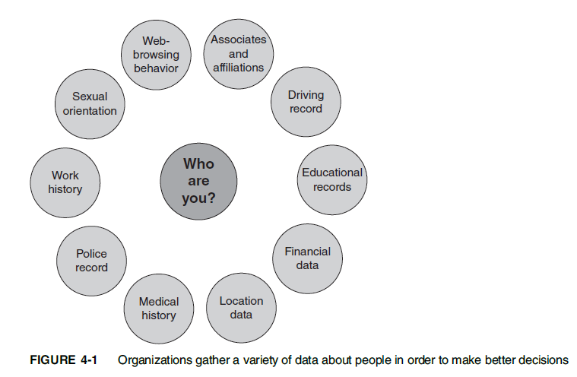
PRIVACY PROTECTION AND THE LAW

Slide 5
PRIVACY PROTECTION AND THE LAW
A combination of approaches—new laws, technical solutions, and privacy policies—is required to balance the scales.
Reasonable limits must be set on government and business access to personal information;
new information and communication technologies must be designed to protect rather than diminish privacy; and
appropriate corporate policies must be developed to set baseline standards for people’s privacy.
Education and communication are also essential.

Slide 6
Information Privacy
A broad definition of the right of privacy is “the right to be left alone—the most comprehensive of rights, and the right most valued by a free people.”
Another concept of privacy that is particularly useful in discussing the impact of IT on privacy is the term information privacy, first coined by Roger Clarke, director of the Australian Privacy Foundation.
Information privacy is the combination of communications privacy (the ability to communicate with others without those communications being monitored by other persons or organizations)
and data privacy (the ability to limit access to one’s personal data by other individuals and organizations in order to exercise a substantial degree of control over that data and their use)

Slide 7
Children’s Personal Data
A recent survey revealed that teens spend more than nine hours per day on average watching television, playing video games, social networking, browsing websites, or doing other things on a computer, smartphone, or tablet.
16 Tweens (children aged 8 to 12) spend about six hours on average consuming media.
Many people feel that there is a need to protect children from being exposed to inappropriate material and online predators; becoming the target of harassment; divulging personal data; and becoming involved in gambling or other inappropriate behavior.
To date, only a few laws have been implemented to protect children online, and most of these have been ruled unconstitutional under the First Amendment and its protection of freedom of expression.

Slide 8
Key Privacy and Anonymity Issues
This section discusses a number of current and important privacy issues, including consumer profiling, electronic discovery, workplace monitoring, and advanced surveillance technology.

Slide 9
Consumer Profiling
Companies openly collect personal information about users when they register at websites, complete surveys, fill out forms, follow them on social media, or enter contests online.
Many companies also obtain personal information through the use of cookies— text files that can be downloaded to the hard drives of users who visit a website, so that the website is able to identify visitors on subsequent visits.
Companies also use tracking software to allow their websites to analyze browsing habits and deduce personal interests and preferences.

Slide 10
Consumer Profiling
The use of cookies and tracking software is controversial because companies can collect information about consumers without their explicit permission.
After cookies have been stored on your computer, they make it possible for a website to tailor the ads and promotions presented to you.
The marketer knows what ads have been viewed most recently and makes sure that they aren’t shown again, unless the advertiser has decided to market using repetition.
Some types of cookies can also track what other sites a user has visited, allowing marketers to use that data to make educated guesses about the kinds of ads that would be most interesting to the user.

Slide 11
Consumer Profiling
Offline, marketing firms employ similarly controversial means to collect information about people and their buying habits.
Each time a consumer uses a credit card, redeems frequent flyer points, fills out a warranty card, answers a phone survey, buys groceries using a store loyalty card, or registers a car with the DMV (Department of Motor Vehicles), the data are added to a storehouse of personal information about that consumer, which may be sold or shared with third parties.
In many of these cases, consumers never explicitly consent to submitting their information to a marketing organization.

Slide 12
Consumer Profiling
Opponents of consumer profiling are concerned that personal data are being gathered and sold to other companies without the permission of consumers who provide the data.
After the data have been collected, consumers have no way of knowing how it is used or who is using it. In fact, consumer data privacy has grown into a major marketing issue.
Companies that can’t protect or don’t respect customer information often lose business, and some become defendants in class action lawsuits stemming from privacy violations.

Slide 13
Consumer Profiling
A data breach is the unintended release of sensitive data or the access of sensitive data (e.g., credit card numbers, health insurance member ids, and Social Security numbers) by unauthorized individuals.
The cost to an organization that suffers a data breach can be quite high—by some estimates nearly $200 for each record lost.
Nearly half the cost is typically a result of lost business opportunity associated with the customers.
Other costs include public relations–related costs to manage the firm’s reputation, and increased customer-support costs for information hotlines and credit monitoring services for victims.

Slide 14
Consumer Profiling
Identity theft is the theft of personal information, which is then used without the owner’s permission.
Often, stolen personal identification information, such as a person’s name, Social Security number, or credit card number, is used to commit fraud or other crimes.
Thieves may use a consumer’s credit card number to charge items to that person’s account, use identification information to apply for a new credit card or a loan in a consumer’s name, or use a consumer’s name and Social Security number to obtain government benefits.
Thieves also often sell personal identification information on the black market.

Slide 15
Surveillance
A number of advances in information technology—such as surveillance cameras and satellite-based systems that can pinpoint a person’s physical location—provide amazing new data-gathering capabilities.
However, these advances can also diminish individual privacy and complicate the issue of how much information should be captured about people’s private lives.

Slide 16
Surveillance
Advocates of advanced surveillance technology argue that people have no legitimate expectation of privacy in a public place and thus Fourth Amendment privacy rights do not apply.
Critics raise concerns about the use of surveillance to secretly store images of people, creating a new potential for abuse, such as intimidation of political dissenters or blackmail of people caught with the “wrong” person or in the “wrong” place.
Critics also raise the possibility that such technology may not identify people accurately.

Slide 17
Surveillance
Camera Surveillance
Surveillance cameras are used in major cities around the world in an effort to deter crime and terrorist activities.
Critics believe that such scrutiny is a violation of civil liberties and are concerned about the cost of the equipment and people required to monitor the video feeds.
Surveillance camera supporters offer anecdotal data that suggest the cameras are effective in preventing crime and terrorism.
They can provide examples in which cameras helped solve crimes by corroborating the testimony of witnesses and helping to trace suspects.

Slide 18
Surveillance
Stalking Apps
Technology has made it easy for a person to track the whereabouts of someone else at all times, without ever having to follow the person.
Cell phone spy software called a stalking app can be loaded onto someone’s cell phone or smartphone within minutes,making it possible for the user to perform location tracking, record calls, view every text message or picture sent or received, and record the URLs of any website visited on the phone.
A built-in microphone can be activated remotely to use as a listening device even when the phone is turned off.
All information gathered from such apps can be sent to the user’s email account to be accessed live or at a later time. Some of the most popular spy software includes Mobile Spy, ePhoneTracker, FlexiSPY, and Mobile Nanny.

Slide 19
Surveillance
Stalking Apps
There is no law that prohibits a business from making an app whose primary purpose is to help one person track another, and anyone can purchase this type of software over the Internet.
(Some users of such software have complained that they contracted malware when downloading stalker apps or that the app failed to work as advertised.)
However, it is illegal to install the software on a phone without the permission of the phone owner.
It is also illegal to listen to someone’s phone calls without their knowledge and permission.

